Slide 1
Current Practice of Hematopoietic Stem Cell Transplant for Primary Immunodeficiencies
Nancy Bunin, MD
Medical Director, Cell Therapy and Transplant Program
Division of Oncology

Slide 2
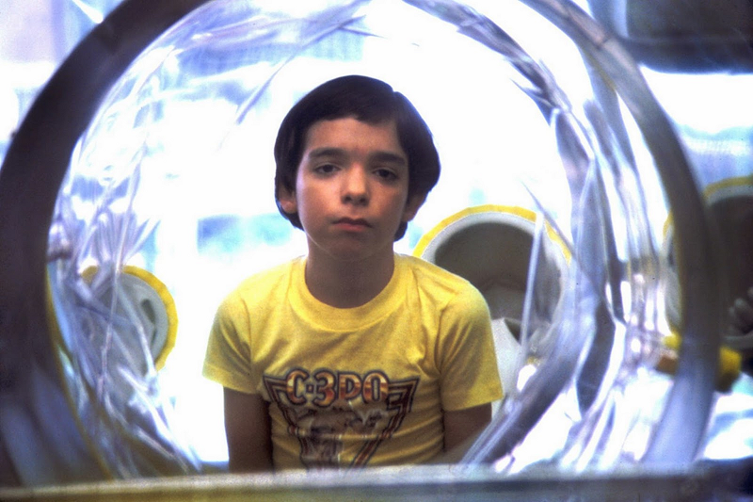
To DISCUSS
SCID
Newborn Screening
Transplant controversies
Other PIDs
HSCT Considerations and new
methods
Gene therapy SCT

Slide 3
One size does not fit all
TYPE of IMMUNODEFICIENCY
SCID- what type??
NK cells present?
B negative, T positive?
ADA deficient?
DNA repair defects?
Non-SCID
Wiskott-Aldrich
Chronic granulomatous disease
Leukocyte adhesion deficiency
IPEX
ETCs

Slide 4
SCID: Severe Combined Immunodeficiency
Incidence: 1/50-70K live births
Lack of T and B cell function, variable NK cell function
Classic Presentation:
CD3 (T cell count) <300; PHA (mitogens) <10% function
Initially completely healthy appearing
Typically present in first 4-7 months of life
OI (thrush/CMV/Pneumocystis), sepsis (BCG/Pseudomonas), cutaneous infections, chronic diarrhea
May have rash
ALC <2000, TRECs low
Variably low immunoglobulins
Fatal in the first year of life without treatment in majority of cases

Slide 5
SCID
4 Major Types Based On Cells Present
T-B+NK-: X-SCID (IL2RG), Jak3
T-B-NK+: RAG 1/2 defects, Radiosensitive Defects (Artemis, DNA-PKcs, NHEJ1(Cernunnos), DL IV, NBS)
T-B-NK-: ADA, PNP
T-B+NK+: IL-7R, LCK, CD3, CD45

Slide 6
SCID Increasingly Diagnosed by NBS Rather than Infection or Family History
% Diagnosed

Slide 7
The Changing Face of SCID
 | Pre NBS | Post NBS
Gender | 79% male | 67% male
Molecular Diagnosis | 48% X-SCID | 66% AR-SCID
 |  | 11%X-SCID
Race/Ethnicity | 81% Caucasian | 65% Hispanic

Slide 8
CONSIDERATIONS…and CONTROVERSIES
Urgency
Emergent
Urgent
Timely
Donor
What kind and how much time?
Conditioning
None, some or all?
Outcomes
What constitutes success?

Slide 9
CONSIDERATIONS…and CONTROVERSIES
Urgency
Emergent
Urgent
Timely----conditioning 2 months
Donor
What kind and how much time?
Unrelated donor---several months? Cord blood- quick? Haplo parent?
Conditioning
None, some or all?
Type of SCID and donor dependent
Outcomes
What constitutes success?

Slide 10
NO HLA MATCHED SIBLING?
DONOR OPTIONS
 | Haploidentical Parent | Unrelated Donor | Unrelated Cord Blood
Time to procurement | Immediate | 1 to many months | 2 weeks
HLA match |  | Up to 1 antigen mismatch | Up to 4/6 mismatch DRB1 match
Processing | Requires complete T depletion | None or T depletion | None
GVHD | Decreased risk with TCD | Increased risk without TCD | Risk dependent upon match
Conditioning | None to some | None to MA | None to MA
Immune recovery | Often only T engraftment | May be complete | May be complete- slower
Boosts? | Available | Available | Not available

Slide 11
Conditioning- a lot, a little less
Myeloablative
Full dose “space making”/stem cell toxins
Common agents: busulfan, cyclophosphamide, total body irradiation >800 cGy
Non-myeloablative/reduced intensity
May include “space making” agents- busulfan- but less than MA
Very immunosuppressive
Common agents: Fludarabine, Campath (alemtuzumab- anti-CD52 MoAb), ATG

Slide 12
Conditioning Required?
ADA deficiency
Reticular dysgenesis
Omenn’s syndrome
CID syndromes
Bare lymphocyte syndrome
?NK cell +

Slide 13
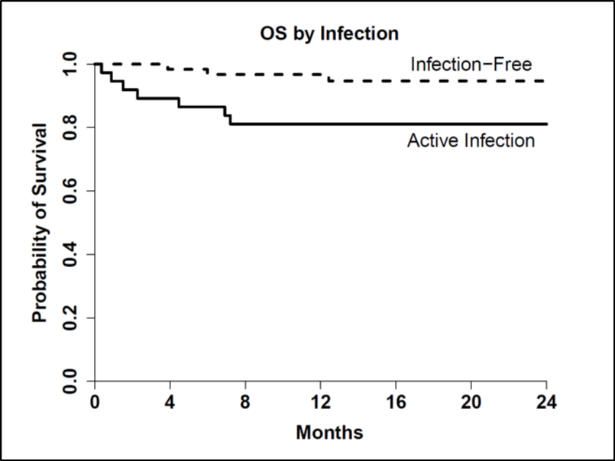
SHORT TERM Transplant Outcomes
Younger Age and Infection Free at Transplant 96%
Short-term survival 90% overall
80% survival if infection present
at time of transplant
No difference by donor type
Heimall et al, Blood 2017

Slide 14
Other PIDs… other issues pre-HSCT
Chronic granulomatous disease
Prior infections (mold, burkholderia)
Chronic colitis and steroids
Wiskott-Aldrich syndrome
Colitis
Thrombocytopenia
Other PIDs
Chronic lung infections bronchiectasis
Cytopenias
Chronic viral infections- CMV, EBV, norovirus, enterovirus

Slide 15
No matched related donors? TCRαβ/CD19+ Depletion for Patients with Primary Immune Deficiencies NCT02990819
Eligibility: SCID, WAS, CGD, immune dysregulation (HLH), other PID
Donors: 10/10 URD, 9/10 URD, haploidentical (non-carrier)
Conditioning:
Myeloablative: busulfan x 4 days, fludarabine 30 mg/m2 x 5, thiotepa 5 mg/kg x 2 OR cyclophosphamide 60 mg/kg x 2 , ATG 3 mg/kg x 3
Reduced intensity: busulfan x 2 days, fludarabine 40 mg/m2 x 4, thiotepa 5 mg/kg x 2, ATG 3 mg/kg x 3
Rituximab x 1 if patient EBV positive
Host immune suppression: MMF x 45 days
Study start December 2016

Slide 16
T cell Depletion: Current strategy
αβ- chain TCRs major inducers of GVHD
γδ-chain TCRs
Recognize target cells through MHC-independent mechanisms
Rapid production of IFN-γ and TNF-a
High activity against intra- and extra-cellular pathogens including CMV
Retain NK cells + TCR γδ+ Tcells-
CD19+- removes B cells and reduces risk EBV LPD

Slide 17
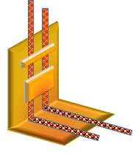
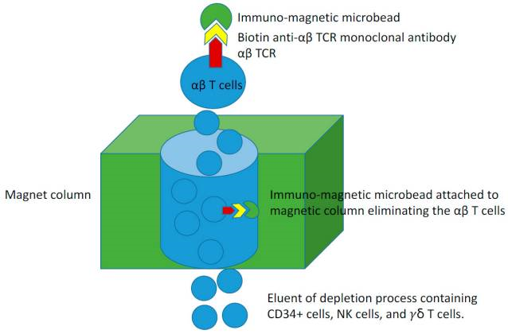
No HLA matched donors? TCRαβ⁺ T cell with CD19⁺ Depletion
Stem Cell Infusion
Depleted Fraction Retains NK cells and TCRγδ⁺ T cells
Peripheral Stem Cells
(PSC)
TCRαβ⁺/CD19⁺ Cells Removed by CliniMACS
T Olson MD PhD

Slide 18
TCRαβ depletion: PID Accrual to date:
N=19 M:F 18:1
Caucasian: 10, Asian: 5, Hispanic: 3, African-American :1
Diagnoses: CGD (9), WAS (3), DOCK8 (1 ), ITK (1), IL10R (1), TTC7A* (1), GATA 2 (1), HLH (1), MAID (1)*
Donors:
URD 10/10: 8
URD 9/10: 9
Haplo: 2 **(expanded access)
Cell Doses
CD34+/kg: Median 10 x 10^{6/}kg (4.86-16.3)
TCRαβ/kg: Median 5.89 x 10⁴/kg (0.8-10)
TCRγδ/kg: Median 9.2 x 10⁶ (0.63-47.8)

Slide 19
PID: Engraftment and GVHD
Thiotepa: 8/17 (47%)
Expanded access (haplo):
TTC7A: Busulfan/fludarabine/ATG
Moesin: Melphalan, thiotepa, fludarabine, ATG (2nd transplant)
ANC (200)- Median, 12 days (10-16)
Platelets- Median 15 days (13-17)
Primary graft failure: 1- CGD
Successful second transplant with different URD and CD3+ depletion
17 patients- >1 month

Slide 20
Chimerism
Median follow up: 8 months (1-24+)
60 days
CD3+: 86% median (1-100)
Myeloid: 100%
One year (n=14):
CD3+ : 93% (38-95)
Myeloid: 100%
Overall: 98% (87-99)
CGD: DHR normal at 30 days

Slide 21
Complications (n=17)
GVHD: 1 (skin, gut)—chronic—resolved
16 discontinued MMF at day +45
2 discontinued <day 30
CMV reactivation: 3/17 (17.6%)
BK cystitis: 6/17 (35%)
VOD: 2
Mortality:
XCGD- Rhizopus, parainfluenza d+55
XCGD*- Burkholderia d+21
MAID (2nd transplant)- ARDS d+115
Paraflu/adeno- ARDS/pulm hemorrhage d+51

Slide 22
PID: Immune Reconstitution after TCRαβ/CD19 depletion
 | 3 mo | 6 mo | 8 mo | 12 mo
CD3+ T cells/μL | 98.5 (3-674) | 265 (31-726) | 532 (72-1191) | 1188 (396-1764)
CD4+ T cells/μL | 44 (0-71) | 136 (20-343) | 278 (47-811) | 504 (275-1205)
CD8+ T cells/μL | 23 (2-598) | 80 (9-437) | 213 (8-784) | 330 (118-1005)
CD4+/CD45RA+ T cells/μL | 7 (0-30) | 48 (1-81) | 108 (3-512) | 262 (2-913)
CD3-/CD16+ &/or 56+ cells/μL | 222 (106-595) | 311 (46-513) | 223 (125-483) | 298 (170-634)
CD19+ B cells/μL | 1 (0-954) | 356 (0-741) | 509 (1-1141) | 448 (47-1757)
CD19+/CD27+/IgD- B cells/μL | 0 (0-7) | 3 (0-16) | 6 (0-40) | 15 (0-57)
7/10 surviving patients are off IVIG at median 4 months (3-8)
Danielle Arnold MD

Slide 23
Outcomes: What constitutes success?
Cannot compare apples to oranges…
Comparing different genetic types of SCID-
US vs Europe: ADA and cytokine dependent survival 80% vs 60% in Europe
Duke vs CHOP: Majority XSCID vs ILRdef SCID
Overall survival vs quality of immune reconstitution
T cell engraftment only?
Mixed chimerism with B, T cell engraftment?
GVHD
Quality of life
Neurocognitive outcomes

Slide 24
Immunology/BMT Collaboration: Joint Program
Immunologist evaluation of babies identified by newborn screening or infection
Lymphocyte phenotyping
Infection assessment
Counseling of family
Genetic testing
HLA typing of baby, sibs, parents Unrelated donor search if no match
Prophylaxis started
Bactrim
Fluconazole
Acyclovir
Immunoglobulin
Joint BMT-Immunology meeting
Joint follow-up post HSCT

Slide 25
Gene Therapy for PIDs
ADA SCID
SCID-X1
CGD
WAS
Must have genetic diagnosis
Autologous: collection of patient bone marrow/PSCs
Lentivirus vector
Busulfan (space maker) conditioning only
Varying degrees of correction
?Longevity

Slide 26
Gene Therapy- Gene Addition
Kohn and Kuo, JACI 2017

Slide 27
LV Gene Therapy for ADA SCID
US trial 2013-2016
20 patients
UK trial 2012-2015
10 patients
At 2 years post-tx,
high levels of gene marking present in PBMC
Normalization of CD3 and CD19 cell counts in 100%,
18/20 US patients are off immunoglobulin replacement
All patients off enzyme replacement

Slide 28
http://rarediseasesnetwork.epi.usf.edu/PIDTC/index.htm
Learn more about inherited disorders of the immune system including newborn screening
Quickly connect with experts in a PIDTC center in your area who diagnose and treat inherited immune disorders
Learn about treatment options and new research studies for patients with these diseases
Help answer questions your physician may have about immune disorders
Connect with patient support groups

Slide 29
Cellular Therapy & Transplant Section Team Approach
Program Manager: Trish Hankins RN
Cell and Gene Therapy Lab
Yongping Wang MD PhD, Director
Stephan Kadauke MD PhD, Asst Director
Immunogenetics Lab
Dmitri Monos PhD, Director
Coordinators: Megan Atkinson, Jocelyn Beale
Nurse Practitioners: Laura Smith, Kim Venella, Erica Wyche, Anne Wohlschlaeger, Ellen Levy
Fertility preservation: Jill Ginsberg M.D.
BMT-Immunology: Jen Heimall MD, Coordinator: Houston Roberson, Fellow: Danielle Arnold MD
BMT doctors
Research Coordinators!!
Barbara McGlynn RN
Margie Tartaglione RN
These protocols require:
Submission to FDA for INDs, cost recovery analyses, PPRC and IRB approvals

